Slide 1







First International Workshop on Video Segmentation
Organizers:
Thomas Brox, University of Freiburg
Fabio Galasso, OSRAM Corp. Tech. Research, Max Planck Institute for Informatics
Fuxin Li, Georgia Institute of Technology
James Matthew Rehg, Georgia Institute of Technology
Bernt Schiele, Max Planck Institute for Informatics

Slide 2
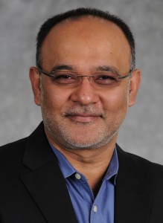
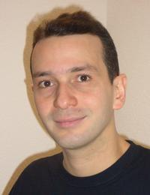
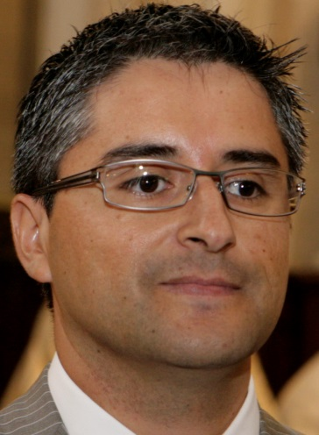
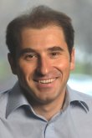
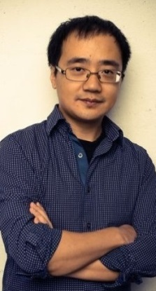

Panel Discussion
Irfan Essa Georgiatech
Vittorio Ferrari University of Edinburgh
René Vidal Johns Hopkins University
Cristian Sminchisescu Lund University
Jue Wang Adobe Systems
Michael Black MPI Intelligent Systems

Slide 3
Recap
Fast growing interest
[Ochs and Malik, ECCV’10], [Vazquez-Reina et al. ECCV’10], [Lezama et al. CVPR’11], [Ochs and Brox ICCV’11], [Lee et al. ICCV’11], [Godec et al. ICCV’11], [Sundaram et al. ICCV’11], [Fragkiadaki and Shi CVPR’12], [Xu and Corso CVPR’12], [Ma and Latecki CVPR’12], [Dragon et al. ECCV’12], [Lee et al. ECCV’12], [Xu et al. ECCV’12], [Zhang et al. CVPR’13], [Chang et al. CVPR’13], [Palou and Salembier CVPR’13], [Tang et al. CVPR’13], [Reso et al. ICCV’13], [Papazoglou and Ferrari ICCV’13], [Van den Bergh et al. ICCV’13], [Banica et al. ICCV’13], [Li et al. ICCV’13], [Jain et al. ICCV’13], [Levinshtein et al. ACCV’10], [Maire and Yu ICCV’13], [Badrinarayanan et al. IJCV’13], [Rota Bulo‘ and Kontschieder CVPR’14], [Chang et al. CVPR’14], [Kae et al. CVPR’14], [Galasso et al. CVPR’14] …

Slide 4
Recap
Diverse problem statements
Separating foreground and background [Papazoglou and Ferrari ICCV’13], [Zhang et al. CVPR’13], [Van den Bergh et al. ICCV’13]
Multiple object segmentation [Vazquez-Reina et al. ECCV’10], [Lee et al. ECCV’12], [Li et al. ICCV’13]
Identifying moving objects [Fragkiadaki and Shi CVPR’12], [Lezama et al. CVPR’11], [Ochs and Brox ICCV’11], [Dragon et al. ECCV’12]
Defining an over-complete supervoxel representation [Chang et al. CVPR’13], [Reso et al. ICCV’13], [Xu and Corso CVPR’12]
Computing hierarchical sets of coarse-to-fine video segmentations [Levinshtein et al. ACCV’10], [Palou and Salembier CVPR’13], [Sundaram et al. ICCV’11], [Xu et al. ECCV’12], [Maire and Yu ICCV’13], [Jain et al. ICCV’13], [Galasso et al. CVPR’14]
Ranking segmentation proposals [Banica et al. ICCV’13], [Lee et al. ICCV’11], [Ma and Latecki CVPR’12], [Zhang et al. CVPR’13]
Supervised/unsupervised, semi-automatic [Badrinarayanan et al. IJCV’13], [Godec et al. ICCV’11], [Tang et al. CVPR’13]
Semantic segmentation [Rota Bulo‘ and Kontschieder CVPR’14], [Chang et al. CVPR’14], [Kae et al. CVPR’14]

Slide 5
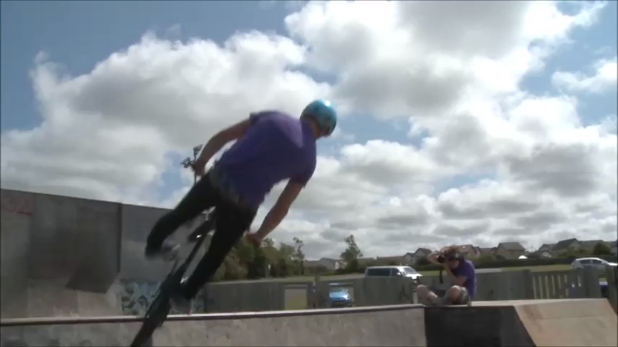
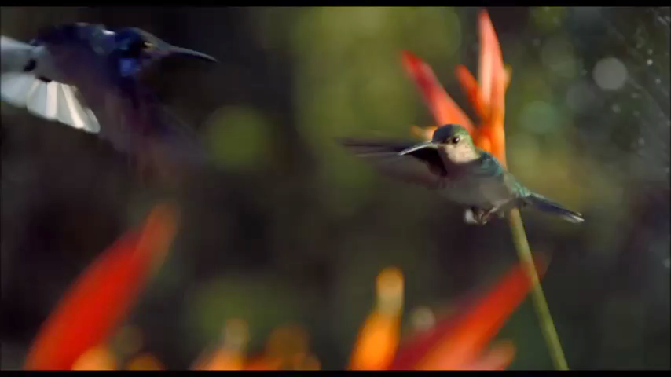
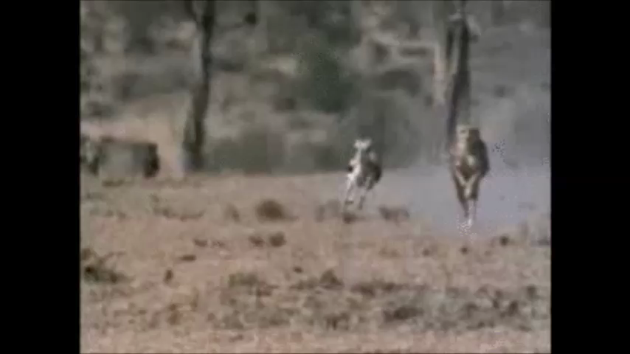
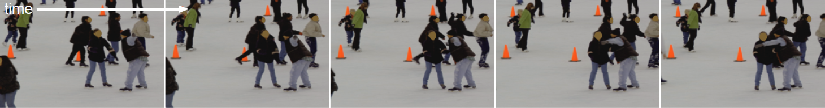
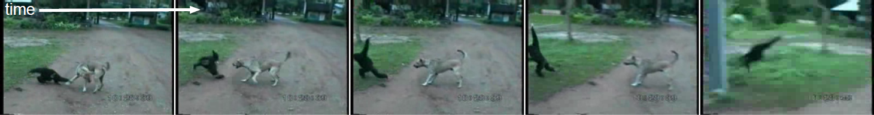
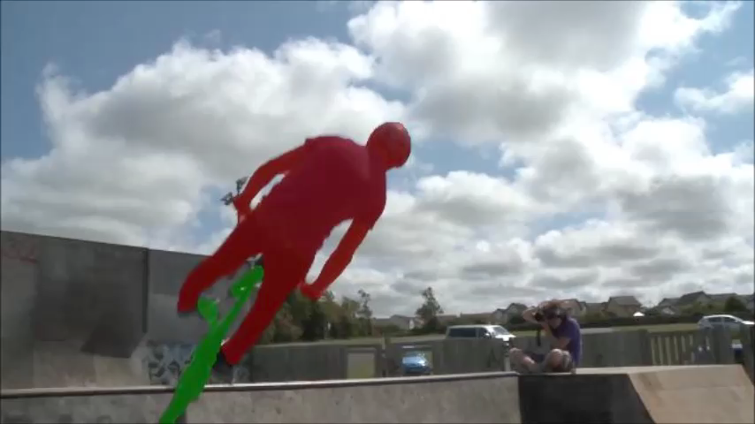
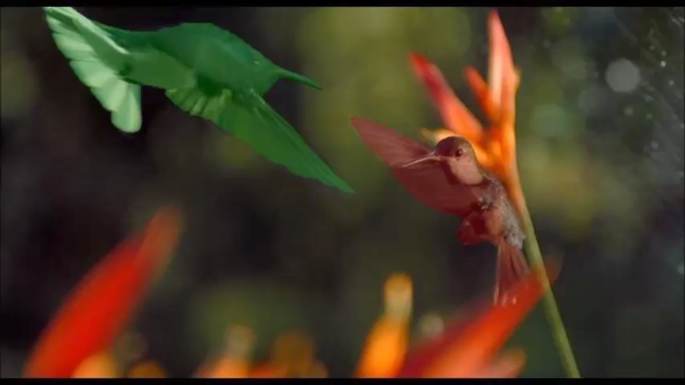
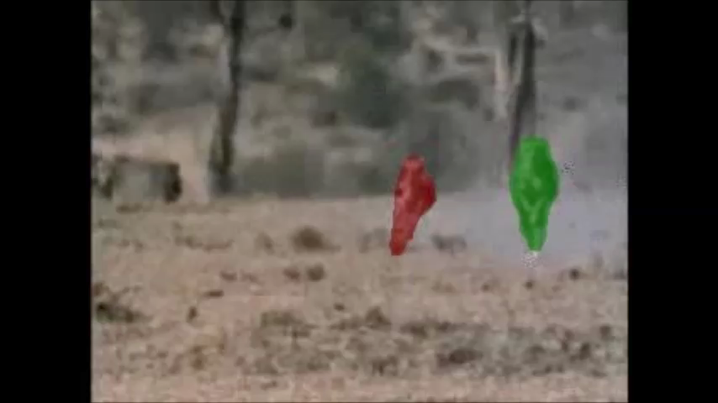
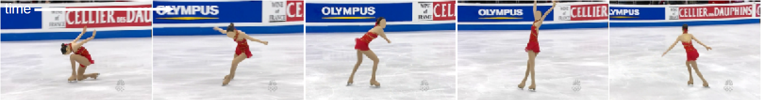

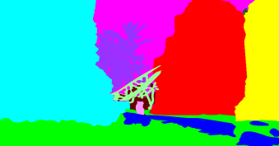

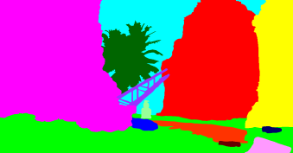
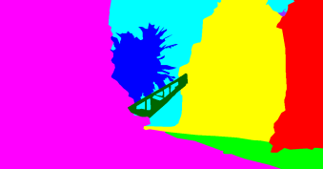
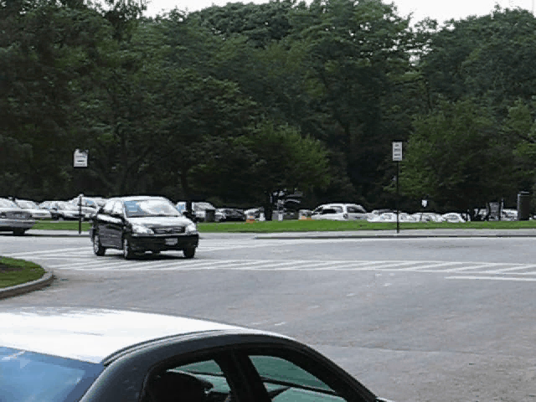
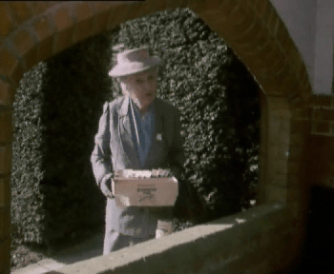


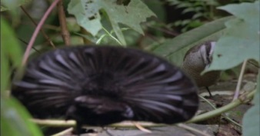
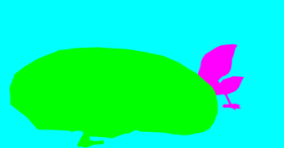

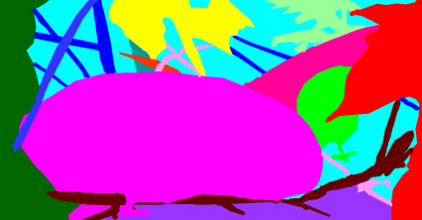

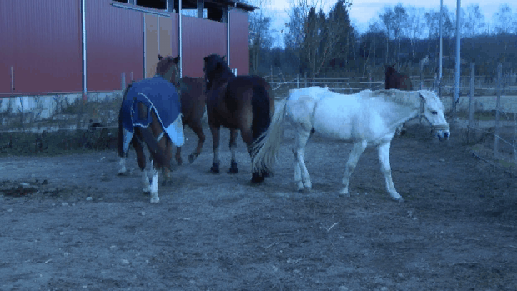
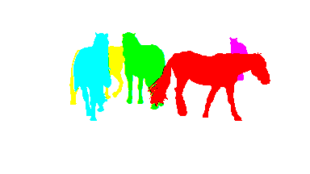
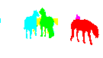

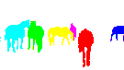











Recap
Different benchmarks
SegTrack v2
LIBSVX
(Video) Object proposals
Supervoxel segmentation
VSB100
FBMS
Unified benchmark
…
Motion segmentation

Slide 6
VSB100: General Task
Volume precision-recall
Xu et al. ECCV 12
Simple baseline
Corso et al. TMI 08
Galasso et al. ACCV 12
Ochs-Brox ICCV 11
Grundmann et al. CVPR 10

Slide 7
VSB100: Motion Subtask
Volume precision-recall
Simple baseline
Ochs-Brox ICCV 11
Galasso et al. ACCV 12
Grundmann et al. CVPR 10

Slide 8
Panel discussion
Video segmentation underperforms wrt image seg. and motion
How should we tackle the temporal dimension?
(Irfan and Michael)
Is video segmentation a standalone problem?
How about recognition and reconstruction?
(Vittorio and Cristian)
What subtasks should we evaluate on?
general tasks, motion subtask, object proposals, superpixels, high precision (cf. Adobe needs us!)
(Jue and René)

